Slide 1


Bird Strikes Trends
Dashboard Report

Slide 2
Introduction
Explore the dynamics of bird strike patterns and analysis, unveiling trends, risks, and mitigation strategies crucial for enhancing aviation safety and minimizing operational disruptions.

Slide 3
Analysis
Bird strikes
Cost
Number of People Injured
Top 50 Airports
Impact to Flights
Top 10 Airlines
Pilot Warned

Slide 4
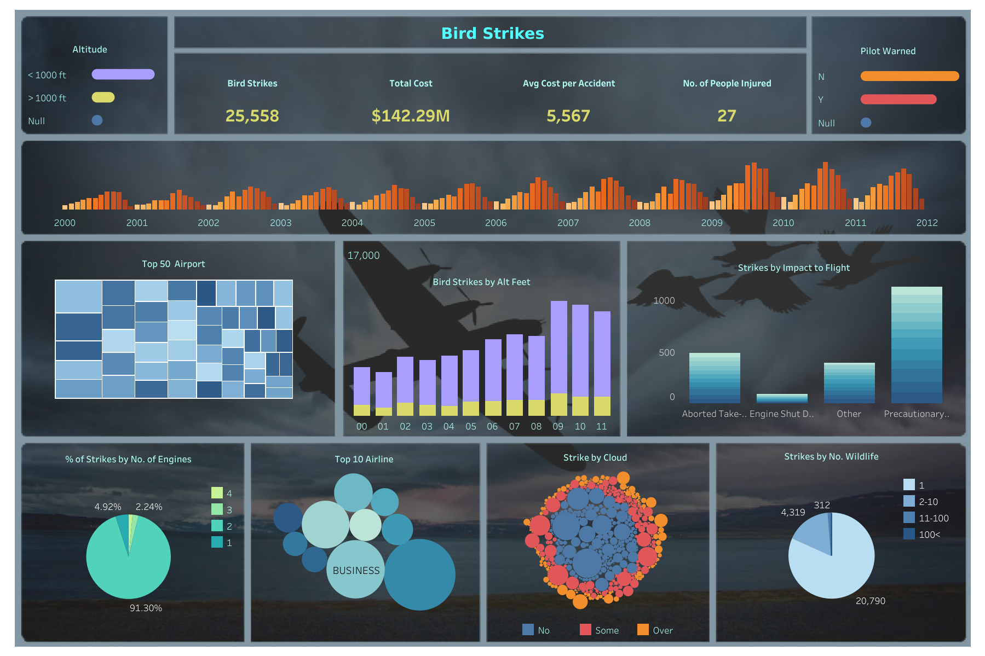
Dashboard

Slide 5
Thank you

